Slide 1
SWE 4803
Lec – 6

Slide 2
Plan Risk Management
The process of defining how to conduct risk management activities for the projects
Process
Output
Plan risk management
Risk management plan

Slide 3
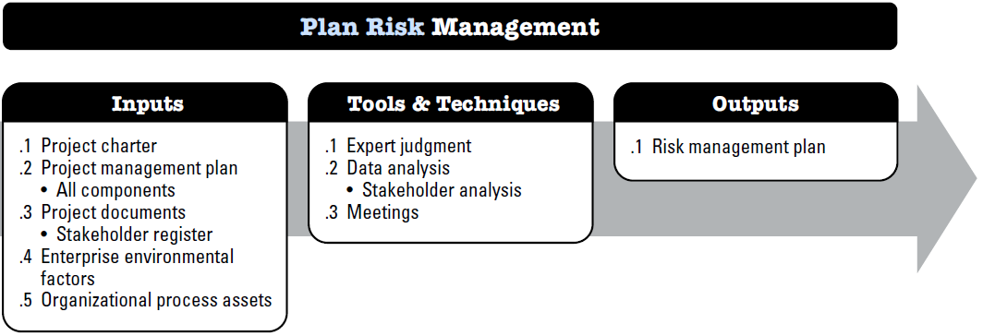
Plan Risk Management

Slide 4
Plan Risk Management
Input:
PROJECT MANAGEMENT PLAN
All components
PROJECT DOCUMENTS
Stakeholder register
Project Charter
Includes high-level project description and boundaries, high-level requirements, and risks.
EEF - overall risk thresholds set by the organizations or key stakeholders.
EEF & OPA
OPA - Organizational risk policy, Risk categories, possibly organized into a risk breakdown structure, Templates for the risk management plan, risk register, and risk report, Lessons learned repository from previous similar projects.

Slide 5
Plan Risk Management
Tools & Techniques:
Expert judgment
Data Analysis
Meetings

Slide 6
Plan Risk Management
Output: Risk Management Plan
describes how risk management activities will be structured and performed and includes
1. Risk strategy. Describes the general approach to managing risk on this project.
2. Methodology. Defines the specific approaches, tools, and data sources that will be used to perform risk management on the project.
3. Roles and responsibilities. Defines the lead, support, and risk management team members for each type of activity described in the risk management plan, and clarifies their responsibilities
4. Funding. Identifies the funds needed to perform activities related to Project Risk Management
5. Timing. Defines when and how often the Project Risk Management processes will be performed throughout the project life cycle and establishes risk management activities for inclusion into the project schedule.
6. Risk categories. Provide a means for grouping individual project risks. A common way to structure risk categories is with a risk breakdown structure (RBS)

Slide 7
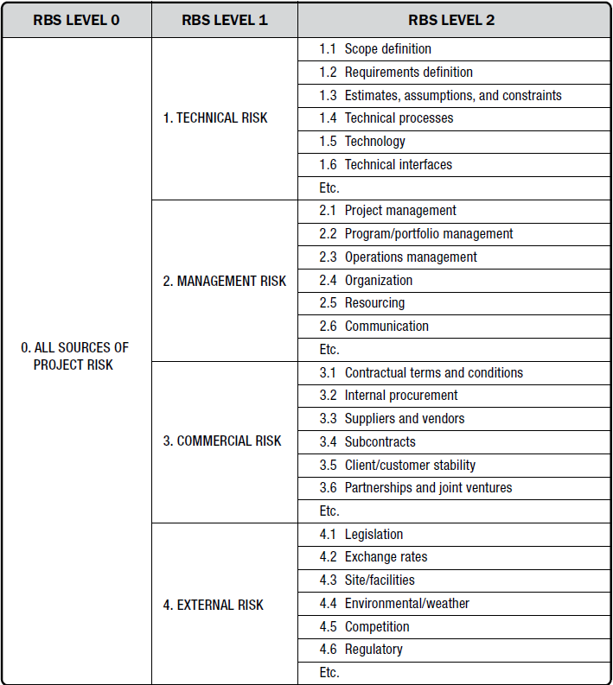

Slide 8
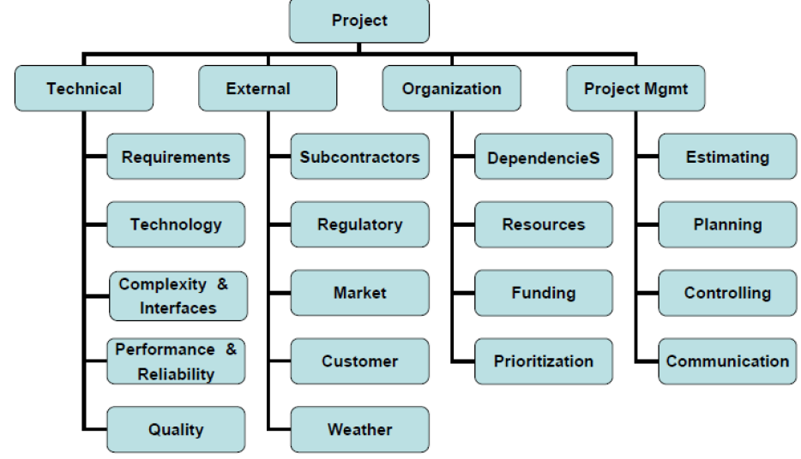

Slide 9
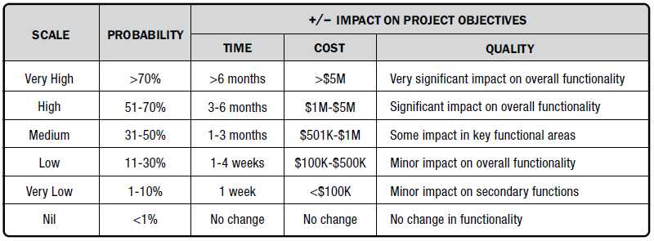
Plan Risk Management
Output: Risk Management Plan
7. Stakeholder risk appetite. stakeholder risk appetite should be expressed as measurable risk thresholds around each project objective. These thresholds will determine the acceptable level of overall project risk exposure, and they are also used to inform the definitions of probability and impacts to be used when assessing and prioritizing individual project risks.
8. Definitions of risk probability and impacts.

Slide 10
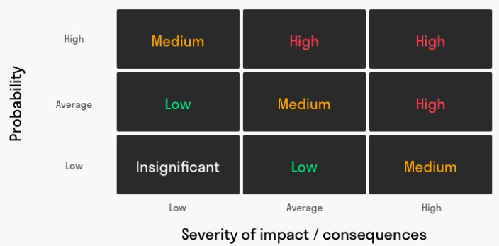
Plan Risk Management
Output: Risk Management Plan
9. probability and impact matrix.
Probability: This explains how likely it is for a risk (uncertain event) to occur. It ranges from 0% to 100%. It won’t be 100% though because that’s entirely certain and it wouldn’t be 0% because then there’s no risk involved.
Impact: Risks create negative outcomes. But their effects vary in terms of costs and impact.

Slide 11
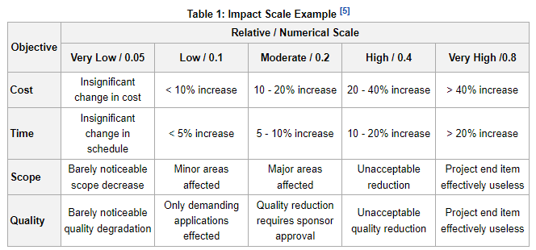
Plan Risk Management
Output: Risk Management Plan
9. probability and impact matrix.

Slide 12
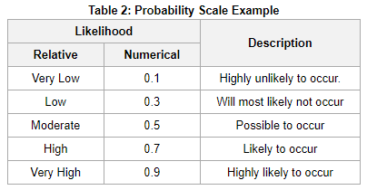
Plan Risk Management
Output: Risk Management Plan
9. probability and impact matrix.

Slide 13
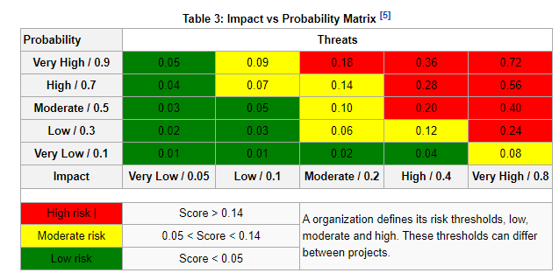
Plan Risk Management
Output: Risk Management Plan
9. probability and impact matrix.
Risk = Impact x Probability

Slide 14
Plan Risk Management
Output: Risk Management Plan
10. Reporting formats Reporting formats define how the outcomes of the Project Risk Management process will be documented, analyzed, and communicated.
11. Tracking. Tracking documents how risk activities will be recorded and how risk management processes will be audited.

Slide 15
Identify Risks
The process of determining which risk may affect the project and documenting their characteristics
Process
Output
Identify risk
Risk register
Risk Report
Project Doc update

Slide 16
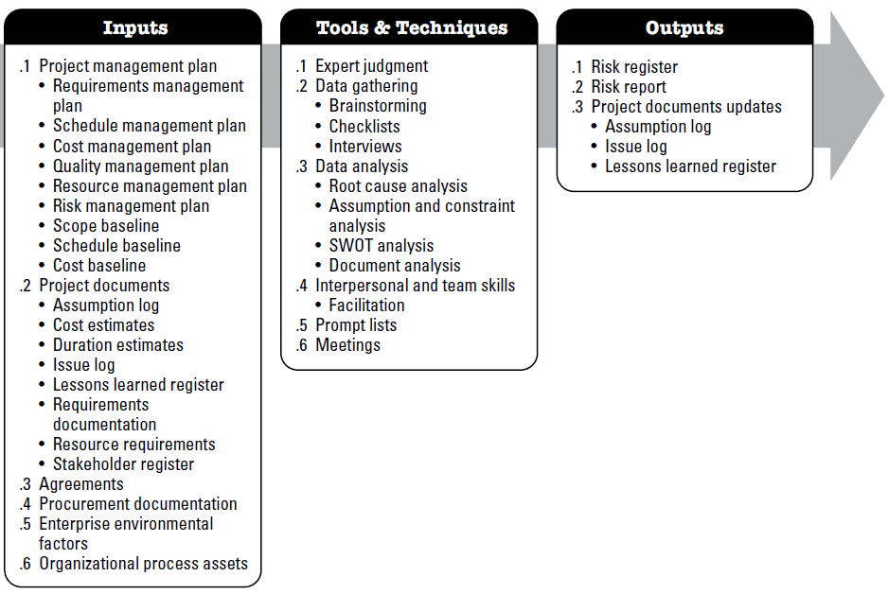
Identify Risks

Slide 17
Identify Risks
Input:
Project management plan
Requirements management plan, Schedule management plan, Cost management plan, Quality management plan, Resource management plan, Risk management plan, Scope baseline, Schedule baseline ,Cost baseline
Project documents
Assumption log ,Cost estimates, Duration estimates, Issue log, Lessons learned register, Requirements documentation, resource requirements, Stakeholder register
Agreements
external procurement of resources
external procurement of resources,
Procurement documentation
EEF - Published material, including commercial risk databases, Benchmarking results, and Industry studies of similar projects.
EEF &
OPA
OPA - Project files, including actual data, Organizational and project process controls, Risk statement formats, and •Checklists from previous similar projects.

Slide 18
Identify Risks
Tools & Techniques:
Expert judgment
Data Gathering - Brainstorming , Checklists, Interviews
Data Analysis – Root Cause Analysis, Assumption and constraint analysis, SWOT Analysis, Document Analysis
Interpersonal and team skills – Facilitation
Prompt list
Meetings
The risk categories in the lowest level of the risk breakdown structure can be used as a prompt list for individual project risks. Some common strategic frameworks are more suitable for identifying sources of overall project risk, for example
PESTLE (political, economic, social, technological, legal, environmental),
TECOP (technical, environmental, commercial, operational, political), or

Slide 19
Identify Risks
Tools & Techniques: Assumption and constraint analysis
What are Assumptions?
Assumptions are things you believe to be true for planning purposes but that may not be guaranteed.
Examples:
Key team members will be available throughout the project
No major changes in client requirements during development
Assumptions introduce uncertainty into a project.
What are Constraints?
Constraints are fixed limitations or restrictions that the project must work within.
Examples:
Project must be completed in 12 weeks
Must use a specific tech stack (e.g., only Python and MySQL)
Constraints are non-negotiable boundaries.
Purpose of the Analysis:
Clarify what is assumed and what is fixed
Identify risks related to incorrect assumptions

Slide 20
Identify Risks
Tools & Techniques: Assumption and constraint analysis
1. List all assumptions
What are you taking for granted?
Where is there uncertainty?
2. List all constraints
What are your non-flexible limits?
3. Validate assumptions
Ask: Is it realistic? What happens if it turns out false?
4. Evaluate impact
What would be the effect on schedule, cost, or scope?
5. Mitigate risks
Plan actions if assumptions fail
Adjust scope or strategy to fit constraints

Slide 21
Identify Risks
Tools & Techniques: SOWT Analysis
SWOT Analysis is a simple planning tool used to identify a project's or business’s Strengths, Weaknesses, Opportunities, and Threats.
Performing SWOT for Risk Identification
SOWT
Threats
- Regulatory compliance risk
- Competition from existing apps
Opportunities
- Growing demand of e-pharmacy app
- Expansion to mobile platform
Weakness
- No Mobile app version yet
- Needs internet access
Strength
- User Friendly Interface
- Realtime inventory Update
1. Gather Key Stakeholders
Involve team leads, clients, domain experts, QA, business analysts, etc.
2. Fill the SWOT Matrix (with Risk Perspective)
S – Strengths (internal, positive)
  Use these to minimize threats or reduce risk impact.
W – Weaknesses (internal, negative)
  Often internal risk sources where failure is more likely..
O – Opportunities (external, positive)
  Can be used to counter or avoid threats.
T – Threats (external, negative)
  These directly indicate external risks.
3. Extract Risks from Weaknesses and Threats
4. Prioritize Risks & Develop Risk Response Plans

Slide 22
Identify Risks
Tools & Techniques: SOWT Analysis
SWOT Analysis is a simple planning tool used to identify a project's or business’s Strengths, Weaknesses, Opportunities, and Threats.
Performing SWOT for Risk Identification
Example: SWOT-Based Risk Identification in a Software Project
1. Gather Key Stakeholders
Involve team leads, clients, domain experts, QA, business analysts, etc.
2. Fill the SWOT Matrix (with Risk Perspective)
S – Strengths (internal, positive)
  Use these to minimize threats or reduce risk impact.
W – Weaknesses (internal, negative)
  Often internal risk sources where failure is more likely..
O – Opportunities (external, positive)
  Can be used to counter or avoid threats.
T – Threats (external, negative)
  These directly indicate external risks.
3. Extract Risks from Weaknesses and Threats
4. Prioritize Risks & Develop Risk Response Plans
SWOT Element | Item | Risk Identified
Weakness | Team unfamiliar with cloud deployment | Risk of delays during deployment
Weakness | No dedicated QA team | Risk of poor quality or customer dissatisfaction
Threat | Change in government health regulations | Risk of needing costly system changes
Threat | Competitor launching similar product | Risk of reduced market interest

Slide 23
Identify Risks
Output:
RISK REGISTER
List of identified risks.
RISK REPORT
The risk report is developed progressively throughout the Project Risk Management process. On completion of the Identify Risks process, information in the risk report may include but is not limited to:
Assumption log.
PROJECT DOCUMENTS UPDATES
Issue log
Lessons learned register
Potential risk owners.
List of potential risk responses.
Sources of overall project risk, indicating which are the most important drivers of overall project risk exposure; and
Summary information on identified individual project risks, such as number of identified threats and opportunities, distribution of risks across risk categories, metrics and trends, etc.

Slide 24
RISK REGISTER
 | Risk description | Potential Risk Owner | Potential risk response
1 | Key developer might leave the project mid-way | Project Manager | Cross-train team members; document knowledge regularly
2 | Requirement changes late in the development cycle | development cycle | Implement change control process; prioritize changes carefully
3 | Integration issues with third-party APIs | Technical Lead | Schedule early integration testing; allocate buffer time

Slide 25
Perform qualitative risk analysis
The process of prioritizing risks for further analysis or action by assessing and combining their probability of occurrence and impact.
Process
Output
Perform qualitative risk analysis
Project Doc update

Slide 26
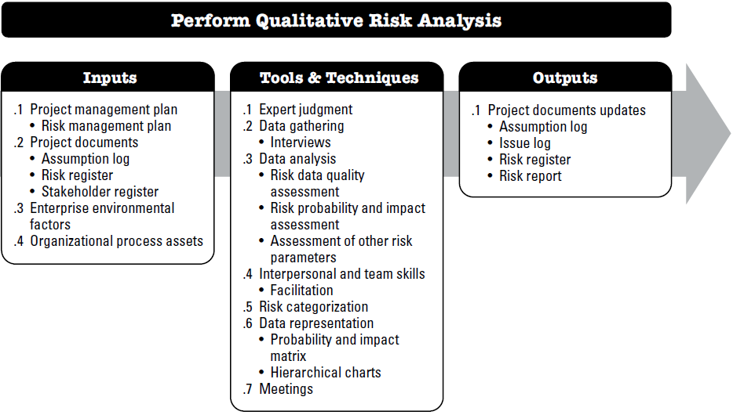
Perform qualitative risk analysis

Slide 27
Perform qualitative risk analysis
Input:
Project management plan
Risk management plan
Project documents
Assumption log
EEF - Industry studies of similar projects, and Published material, including commercial risk databases or checklists.
EEF & OPA
Risk register
Stakeholder register
OPA - The organizational process assets that can influence Perform Qualitative Risk Analysis include but are not limited to information from similar completed projects.

Slide 28
Perform qualitative risk analysis
Tools & Techniques:
Expert judgment
Data Gathering - Interviews
Data Analysis – Risk data quality assessment, Risk probability and impact assessment , Assessment of other risk parameters
Interpersonal and team skills – Facilitation
Risk Categorization
Data Representation – Probability and impact matrix, Hierarchical charts
Meetings

Slide 29
Perform qualitative risk analysis
Tools & Techniques:
Assessment of other risk parameters
Risk Parameter | Definition | Example
Urgency | Time period within which a risk response must be implemented to be effective. Short period = high urgency. | A critical security vulnerability must be patched within 24 hours to avoid breach.
Proximity | Time before the risk might impact project objectives. Short period = high proximity. | Third-party API deprecation scheduled in 2 weeks will affect integration.
Dormancy | Time after risk occurrence before its impact is noticed. Short period = low dormancy. | A data corruption bug causes immediate system crash noticed by users.
Manageability | Ease with which the risk owner can manage or mitigate the risk. High = easy to manage. | Backup procedures allow easy recovery from data loss risk.
Controllability | Degree to which the risk owner can control the risk outcome. High = easy to control. | Developer can quickly fix a known bug, controlling defect impact.

Slide 30
Perform qualitative risk analysis
Tools & Techniques:
Assessment of other risk parameters
Risk Parameter | Definition | Example
Detectability | Ease with which risk occurrence or impending occurrence can be detected. High = easy to detect. | Automated monitoring alerts team when server CPU usage spikes.
Connectivity | Extent to which the risk is related to other project risks. High = highly connected. | Delay in database design impacts backend and testing schedules.
Strategic Impact | Potential for risk to affect organizational strategic goals, positively or negatively. High = major effect. | A major cloud outage disrupts service for enterprise clients.
Propinquity | Degree to which stakeholders perceive the risk as significant. High = highly significant. | Customers express strong concerns about app privacy features, making privacy risks significant.

Slide 31
Perform qualitative risk analysis
Output:
Assumption log.
Issue log.
Risk register.
Risk report.
Risk description | Category | Probability | Impact | Overall rating | Potential Risk Owner | Potential risk response
Key developer might leave the project mid-way | Organizational | .4 | .5 | .20 | Project Manager | Cross-train team members; document knowledge regularly
Integration issues with third-party APIs | Technical | .4 | .7 | .28 | Technical Lead | Schedule early integration testing; allocate buffer time

Slide 32
Perform quantitative risk analysis
The process of numerically analyzing the effect of identified risks on overall project objectives
Process
Output
Perform quantitative risk analysis
Project Doc update

Slide 33
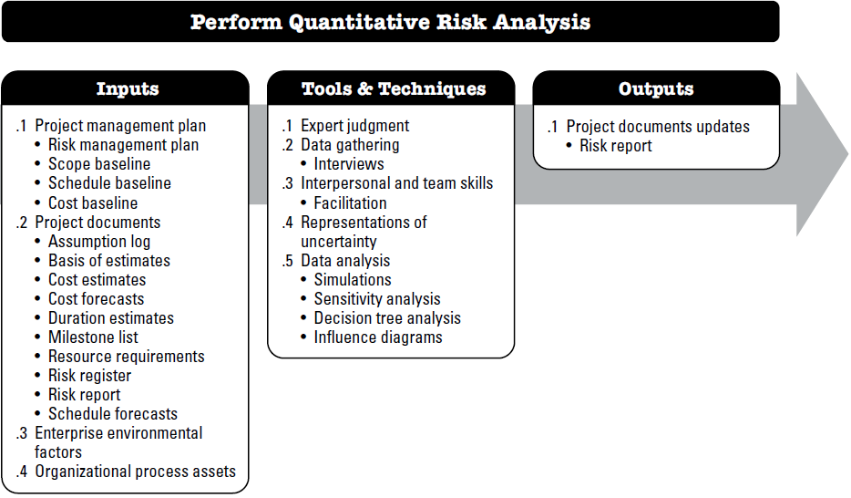
Perform quantitative risk analysis

Slide 34
Perform quantitative risk analysis
Input:
Project management plan
Risk management plan
Project documents
Assumption log, Basis of estimates, Cost estimates, Cost forecasts, Duration estimates, Milestone list, Resource requirements, Risk register, Risk report, Schedule forecasts
EEF - Industry studies of similar projects, and Published material, including commercial risk databases or checklists.
EEF & OPA
OPA - The organizational process assets that can influence Perform Qualitative Risk Analysis include but are not limited to information from similar completed projects.
cope baseline
Schedule baseline
Cost baseline

Slide 35
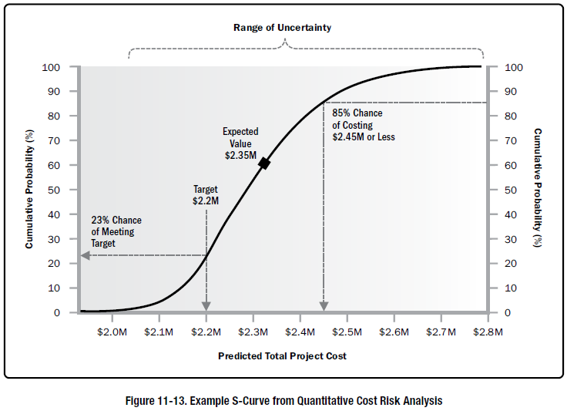
Perform quantitative risk analysis
Tools & Techniques:
Expert judgment
Data Gathering
Interpersonal and team skills
Representation of uncertainty – using probability distribution…
Data analysis – simulation, sensitivity analysis, decision tree analysis
Meetings

Slide 36
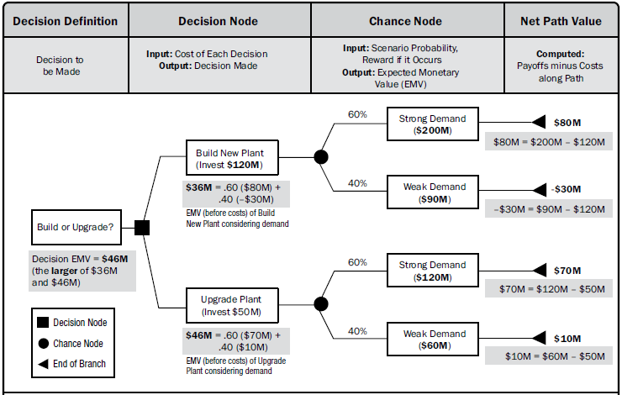
Perform quantitative risk analysis
As a project manager you need to decide whether to invest $120M to Build a new data center or to invest only $50M to upgrade the existing data center. If you decide to build a new one, then there is 60% chance that the new data center will help to generate revenue of $200M and 40% chance of generating revenue of $90M. Also, if you decide to upgrade the existing data center then there is 60% chance that it will help to generate revenue of $120M and 40% chance of generating revenue of $60M. Using proper data analysis method make your decision for the given scenario.

Slide 37
Perform quantitative risk analysis

Slide 38
Perform quantitative risk analysis
Output:
Assumption log.
Issue log.
Risk register.
Risk report.
Risk description | Probability | Cost impact | Expected Monetary Value (Probability x Impact) | Potential risk response
Networking hardware may fail during the project | .4 | - 50,000 | - 20000 | Taking action to purchase new HW within a short time.
Due to hardware failure data may be lost | .3 | - 20000 | - 6000 | Arrange some data backup process

Slide 39
Perform quantitative risk analysis
Your team has identified three risks with probabilities of 10%, 50%, and 35% during risk management planning. If the first two risks occur, they will cost you 5,000 USD and 8,000 USD; however, the third risk will give you 10,000 USD if it occurs.
Determine the expected monetary value of these risk events.
The expected monetary value (EMV) of three events = EMV of first event + EMV of second event + EMV of third event
= 0.10 * (–5,000) + 0.50 * (–8,000) + 0.35 * 10,000
= –1,000
Vendor A has a 50% probability of being on-time, a 30% probability of being late at an additional cost of $40,000 and a 20% probability of delivering early at a savings of $20,000. Vendor B has a 30% probability of being on-time, a 40% probability of being late at an additional cost of $40,000 and a 30% probability of delivering early at a savings of $20,000. Which vendor to chose ?
Outcome | Probability | Cost Impact (USD) | EMV = Probability × Impact
On-time | 50% (0.50) | $0 | 0.50 × 0 = $0
Late | 30% (0.30) | –$40,000 | 0.30 × (–40,000) = –$12,000
Early | 20% (0.20) | +$20,000 | 0.20 × 20,000 = +$4,000
EMV_{A​}=0−12,000+4,000=−8,000​
EMV_{B}​=0−16,000+6,000=−10,000​
Choose Vendor A as it has a less negative EMV, meaning less expected loss and lower risk.

Slide 40
Perform quantitative risk analysis
Your team has identified three risks with probabilities of 10%, 50%, and 35% during risk management planning. If the first two risks occur, they will cost you 5,000 USD and 8,000 USD; however, the third risk will give you 10,000 USD if it occurs.
Determine the expected monetary value of these risk events.
The expected monetary value (EMV) of three events = EMV of first event + EMV of second event + EMV of third event
= 0.10 * (–5,000) + 0.50 * (–8,000) + 0.35 * 10,000
= –1,000
Vendor A has a 50% probability of being on-time, a 30% probability of being late at an additional cost of $40,000 and a 20% probability of delivering early at a savings of $20,000. Vendor B has a 30% probability of being on-time, a 40% probability of being late at an additional cost of $40,000 and a 30% probability of delivering early at a savings of $20,000. Which vendor to chose ?
EMV_{A​}=0−12,000+4,000=−8,000​
Outcome | Probability | Cost Impact (USD) | EMV = Probability × Impact
On-time | 30% (0.30) | $0 | 0.30 × 0 = $0
Late | 40% (0.40) | –$40,000 | 0.40 × (–40,000) = –$16,000
Early | 30% (0.30) | +$20,000 | 0.30 × 20,000 = +$6,000
EMV_{B}​=0−16,000+6,000=−10,000​
Choose Vendor A as it has a less negative EMV, meaning less expected loss and lower risk.

Slide 41
Plan Risk Response
The process of developing options and actions to enhance opportunities and to reduce threats to project objectives.
Process
Output
Plan risk Response
Change Request
PM plan updates
Project documents update

Slide 42
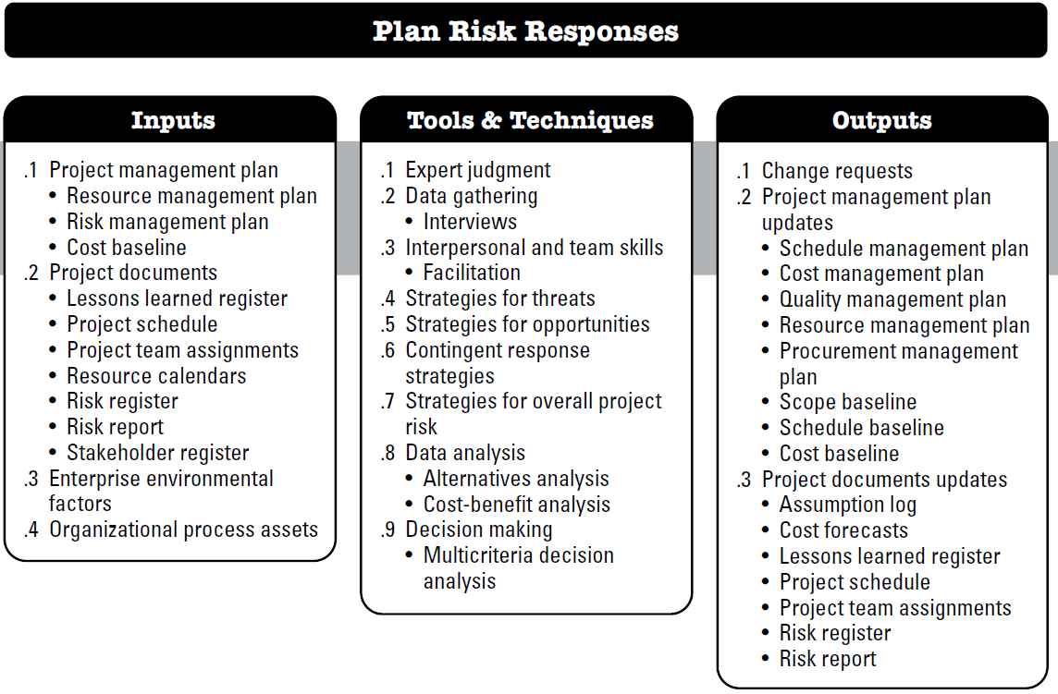
Plan risk Response

Slide 43
Plan risk Response
Input:
Project management plan
Risk management plan
Project documents
Lessons learned register, Project schedule, Project team assignments, Resource calendars, Risk register, Risk report, Stakeholder register
EEF - risk appetite and thresholds of key stakeholders.
EEF & OPA
OPA - Templates for the risk management plan, risk register, and risk report, Historical databases, Lessons learned repositories from similar projects.
Resource Management plan
Cost baseline

Slide 44
Plan risk Response
Tools & Techniques:
Expert judgment
Data Gathering
Interpersonal and team skills
Strategies for threats
Strategies for positive risks opportunities
Contingent response strategies
Strategies for overall project risk
Data analysis
Decision making

Slide 45
Plan risk Response
Tools & Techniques:
Transfer - One effective way
to deal with a risk is to pay someone else to accept it for you. The most
common way to
do this is to buy
insurance.
Strategies for threats
  Avoid
  Mitigate
  Transfer
  accept
Mitigate - If you can’t avoid the risk, you can mitigate it. This means taking some sort of action that will cause it to do as little damage to your project as possible.
avoid it—if
you can prevent it
from happening,
it definitely won’t
hurt your project.
Accept- If you can’t avoid the risk, and there’s nothing you can do to reduce its
impact, then accepting it
is your only choice.

Slide 46
Plan risk Response
Tools & Techniques:
Strategies for positive risks opportunities
  Escalate : Transfer to someone better able to ensure the opportunity occurs.
  Exploit : Ensure the opportunity is realized. Assign best talent and prioritize work
  Share : Transfer to a 3rd party or spin up group to ensure value captured
  Enhance: increase probability or impact.
  Accept : agree to take no action, but promote and encourage.
Scenario: You're managing a software project with a chance to complete early and gain a $10,000 bonus.
Escalate
Hand the opportunity over to someone with more authority or capability to realize it (e.g., senior management).
Example:
You inform the program director about the early-completion bonus and ask them to negotiate a cross-team support agreement or reallocate extra resources to make it happen.
Result: The opportunity is managed at a higher level — you don’t directly handle it.

Slide 47
Plan risk Response
Tools & Techniques:
Strategies for positive risks opportunities
  Escalate : Transfer to someone better able to ensure the opportunity occurs.
  Exploit : Ensure the opportunity is realized. Assign best talent and prioritize work
  Share : Transfer to a 3rd party or spin up group to ensure value captured
  Enhance: increase probability or impact.
  Accept : agree to take no action, but promote and encourage.
Scenario: You're managing a software project with a chance to complete early and gain a $10,000 bonus.
Exploit
Take action to guarantee the opportunity happens — no chance is left to luck.
Example:
You assign your best developers, cancel less important tasks, and prioritize this project to guarantee early delivery.
Result: You’re actively making the opportunity happen — not just hoping for it.

Slide 48
Plan risk Response
Tools & Techniques:
Strategies for positive risks opportunities
  Escalate : Transfer to someone better able to ensure the opportunity occurs.
  Exploit : Ensure the opportunity is realized. Assign best talent and prioritize work
  Share : Transfer to a 3rd party or spin up group to ensure value captured
  Enhance: increase probability or impact.
  Accept : agree to take no action, but promote and encourage.
Scenario: You're managing a software project with a chance to complete early and gain a $10,000 bonus.
Share
Collaborate with a third party that can maximize the opportunity.
Example:
You partner with a subcontractor or external team to deliver a feature faster, ensuring you capture the early delivery bonus together..
Result: You share the benefits and the work with others.

Slide 49
Plan risk Response
Tools & Techniques:
Strategies for positive risks opportunities
  Escalate : Transfer to someone better able to ensure the opportunity occurs.
  Exploit : Ensure the opportunity is realized. Assign best talent and prioritize work
  Share : Transfer to a 3rd party or spin up group to ensure value captured
  Enhance: increase probability or impact.
  Accept : agree to take no action, but promote and encourage.
Scenario: You're managing a software project with a chance to complete early and gain a $10,000 bonus.
Enhance
Take steps to increase the probability or impact of the opportunity.
Example:
You optimize sprint planning, automate test cases, and reduce blockers — making it more likely to finish early.
Result: The chance of realizing the opportunity increases..

Slide 50
Plan risk Response
Tools & Techniques:
Strategies for positive risks opportunities
  Escalate : Transfer to someone better able to ensure the opportunity occurs.
  Exploit : Ensure the opportunity is realized. Assign best talent and prioritize work
  Share : Transfer to a 3rd party or spin up group to ensure value captured
  Enhance: increase probability or impact.
  Accept : agree to take no action, but promote and encourage.
Scenario: You're managing a software project with a chance to complete early and gain a $10,000 bonus.
Accept
Take no proactive action, but stay open to the opportunity and encourage it where possible.
Example:
You continue the project as planned, but encourage the team to keep up the pace. If early completion happens, that’s great.
Result: You’re not investing in it directly, but you won’t ignore it either.

Slide 51
Plan risk Response
Tools & Techniques:
Contingent response strategies
Some responses are designed for use only if certain events occur.
Events that trigger the contingency response, such as missing intermediate milestones or gaining higher priority with a seller, should be defined and tracked.
Risk responses identified using this technique are often called contingency plans or fallback plans and include identified triggering events that set the plans in effect.
Contingency Plan = your first line of defense when a risk occurs.
Fallback Plan = your Plan B in case that first line doesn’t work.
Example
Risk: Your team is developing a mobile app, and there's a risk that the external payment gateway API might become unavailable close to release.
Contingency Plan: If the payment API is down during testing, use a mock payment service temporarily.
Fallback Plan: If the vendor cannot resolve the issue before release, switch to a different payment provider you've already evaluated.

Slide 52
Plan risk Response
Output:
Project management plan Update
Management plans and baselines
Project documents Update
Risk register
Planned risk responses may result in a change request to the cost and schedule baselines or other components of the project management plan.
Change Request
Assumption log
Technical documents
Change requests

Slide 53
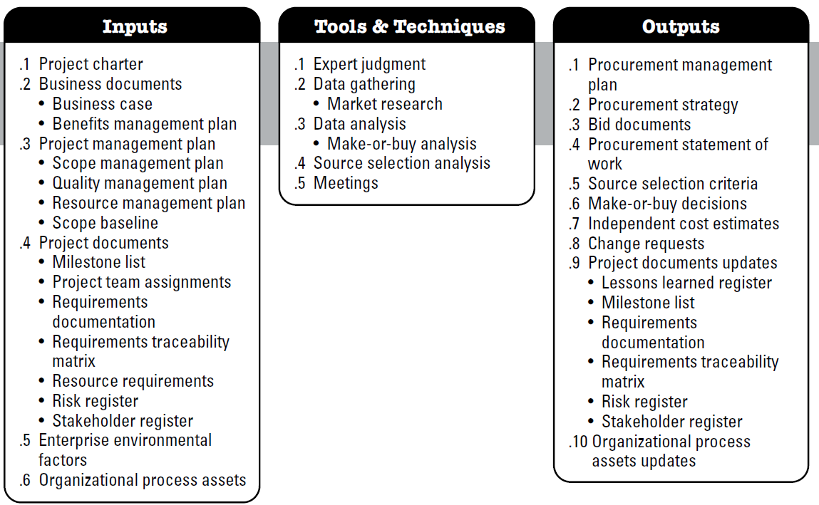
Plan Procurement Management
The process of documenting project purchasing decisions, specifying approaches and identify potential sellers.

Slide 54
Plan Procurement Management
Input:
Project charter
Business documents - Business case, Benefits management plan
Project management plan - Scope baseline, scope, quality and resource management plan
Project documents- Milestone list, Project team assignment, Requirements documentation, Requirements traceability matrix , Resource requirements, Risk register, Stakeholder register
EEF - Marketplace conditions; Products, services, and results that are available in the marketplace; Sellers, including their past performance or reputation;
OPA - Preapproved seller list, Contract type

Slide 55
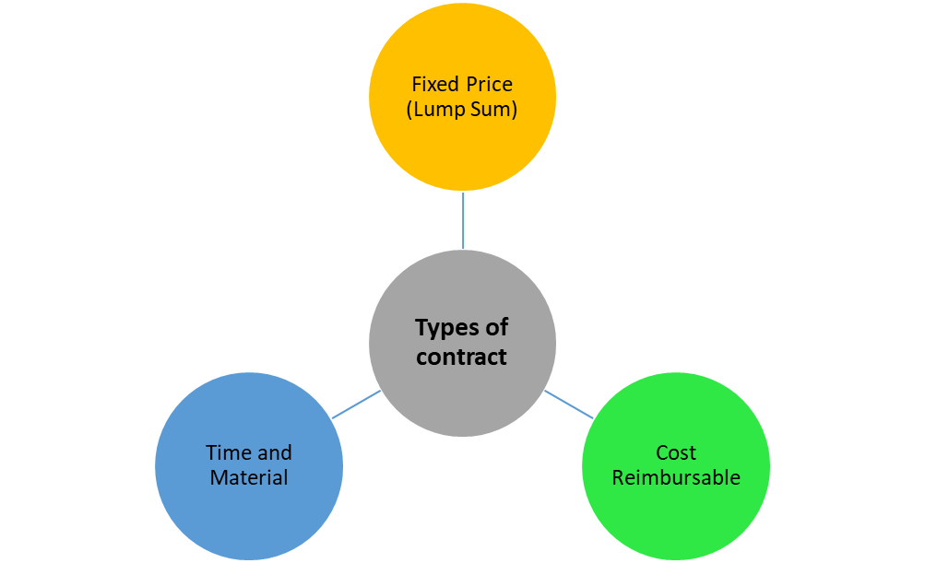
Plan Procurement Management
Input:
Contract type
Firm Fixed-Price contract (FFP)
Fixed-Price Incentive Fee contract (FPIF)
Fixed-Price with Economic Price Adjustment Contract (FP-EPA)
Cost-Plus Fixed Fee (CPFF)
Cost-Plus Incentive Fee (CPIF)
Cost-Plus Award Fee (CPAF)
Cost-Plus Percentage of Cost (CPPC)

Slide 56
Plan Procurement Management
Input:
Contract type
Fixed Price Contracts, a Fixed Amount of consideration is required to be paid by the Buyer to the Seller for the Specified Work.
Firm Fixed Price (FFP): The seller must complete the job or supply the product or service within an agreed amount of time and at a set price.
Fixed Price Incentive Fee (FPIF): Identical to a FFP contract except that the seller may receive an additional monetary incentive if they perform well – for example, completing the project ahead of schedule.
Fixed Price with Economic Price Adjustment (FP-EPA): Used in multi-year agreements to protect the seller from inflation – for example, costs will increase 3% after a certain amount of time.

Slide 57
Plan Procurement Management
Input:
Contract type
Cost Reimbursable Contracts, the Buyer is required to reimburse Actual Cost of Work and an Agreed Upon Fee to the Seller for the Specified Work.
Cost Plus Fixed Fees Contract (CPFF)
the seller is paid for all incurred costs plus a fixed fee, regardless of their performance. The buyer bears the risk. CPFF contracts keep the seller safe from risks.
Example: Total cost plus 25,000 USD as a fee.
Example
Let’s say a company hires a contractor to develop a new product.
  Estimated cost: $10000
  Fixed fee: $1000
If the final cost turns out to be:
$10000 → Buyer pays $11000
$12000 → Buyer still pays only cost ($12000) + fixed fee ($1000) = $13000
Fixed fee doesn’t change, even if the project cost goes higher or lower.

Slide 58
Plan Procurement Management
Input:
Contract type
Cost Reimbursable Contracts, the Buyer is required to reimburse Actual Cost of Work and an Agreed Upon Fee to the Seller for the Specified Work.
Cost Plus Incentive Fees Contract (CPIF)
A CPIF contract is a type of agreement where the buyer pays the seller for:
All allowable actual costs (like labor, materials, etc.),
Plus an incentive fee that depends on performance, such as finishing under budget.
In a CPIF contract, the incentive is a motivating factor for the seller. Generally, an incentive is a percentage of the savings that buyer and seller share.
Why Use CPIF?
Buyer Benefits:
  Encourages the seller to save costs, since they get rewarded for being efficient.
Seller Benefits:
  Gets reimbursed for all allowed costs.
  Can earn more by performing well.
Example:
Target cost = $100,000
Target fee = $10,000
Incentive rate = 80/20 (Buyer keeps 80% of savings, seller gets 20%)
Scenario 1: Seller finishes for $90,000
  Cost savings = $10,000
  Seller gets 20% of $10,000 = $2,000 bonus
Total paid to seller = $90,000 (cost) + $10,000 (base fee) + $2,000 (bonus) = $102,000

Slide 59
Plan Procurement Management
Input:
Contract type
Cost Reimbursable Contracts, the Buyer is required to reimburse Actual Cost of Work and an Agreed Upon Fee to the Seller for the Specified Work.
Cost Plus Incentive Fees Contract (CPIF)
A CPIF contract is a type of agreement where the buyer pays the seller for:
All allowable actual costs (like labor, materials, etc.),
Plus an incentive fee that depends on performance, such as finishing under budget.
In a CPIF contract, the incentive is a motivating factor for the seller. Generally, an incentive is a percentage of the savings that buyer and seller share.
Why Use CPIF?
Buyer Benefits:
  Encourages the seller to save costs, since they get rewarded for being efficient.
Seller Benefits:
  Gets reimbursed for all allowed costs.
  Can earn more by performing well.
Example:
Target cost = $100,000
Target fee = $10,000
Incentive rate = 80/20 (Buyer keeps 80% of savings, seller gets 20%)
Scenario 2: Seller spends $110,000
  Overrun = $10,000
  Seller loses 20% of overrun = $2,000 fee reduction
Total paid to seller = $110,000 (cost) + $10,000 (fee) – $2,000 (penalty) = $118,000

Slide 60
Plan Procurement Management
Input:
Contract type
Cost Plus Award Fee Contracts (CPAF)
A CPAF contract is a type of agreement where the buyer pays the seller for:
All allowable actual costs of the project,
An award fee based on the buyer’s subjective evaluation of the seller’s performance.
Example:
  Allowable cost = $100,000
  Maximum award fee = $15,000
If the seller does an excellent job:
  Buyer awards full $15,000 → Total paid = $115,000
If the seller performs just okay:
  Buyer awards $8,000 → Total paid = $108,000
If the seller’s performance is poor:
  Buyer awards $0 → Total paid = $100,000

Slide 61
Plan Procurement Management
Input:
Contract type
Cost Plus Percentage of Cost (CPPC)
Here, the seller is paid for all costs incurred, plus a percentage of these costs. Buyers often do not prefer this type of contract because the seller might artificially increase the costs to earn a higher profit.
Example: Total cost plus 15% of the cost as a fee to the contractor.
Example:
  Seller incurs $100,000 in costs.
  Contract says seller earns 15% profit.
Buyer pays = $100,000 (cost) + 15% of $100,000 (=$15,000) = $115,000
If actual cost increases to $120,000, then:
Buyer pays = $120,000 + 15% of $120,000 = $138,000
Seller earns more profit by spending more.

Slide 62
Plan Procurement Management
Input:
Contract type
Time & Material Contracts
This is a hybrid of Fixed-Price and Cost-Reimbursable contracts.
Here, both parties share the risk.
The buyer pays the seller based on:
    Time spent (e.g., hourly or daily rate),
    Materials used (billed at actual cost or a markup).
Common when the scope of work is not fully defined and flexibility is needed.
Example:
  Hourly rate: $50/hour
  Estimated hours: 100
  Material cost: $2,000
When to Use T&M Contracts?
  Projects with uncertain or evolving scope.
  Short-term contracts or tasks like repairs, consulting, R&D, etc.
  When you want a fast startup without full requirements.
  Buyer pays:
  Labor cost = $50 × 100 = $5,000
  Materials cost = $2,000
  Total = $7,000
If the work takes 120 hours instead, the buyer pays more:
$50 × 120 = $6,000 + materials

Slide 63
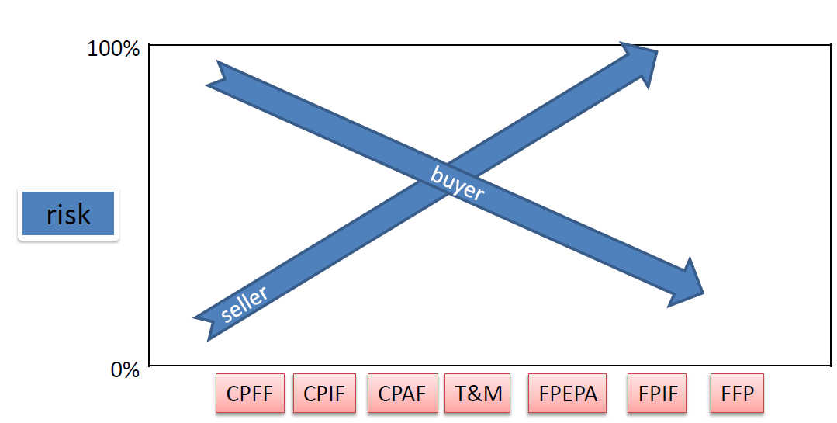
Plan Procurement Management
Input:
Contract type
Which “Type of Contract” is More Risky?
Who is taking the Project Risk – “Buyer” or the “Seller”?
A Risk that is high for the Buyer will be low for the Seller and vice versa
Fixed Price (FP) - Risk is low for the Buyer while it is high for the Seller.
Cost Plus (CP) - Risk is low for the Seller while it is high for the Buyer
Time & Material (T&M) - Both the Buyer and the Seller share the Risk.

Slide 64
Incentive calculation
Let us look at some terms
Target Cost – A pre-defined goal (cost objective) set by the buyer for the seller.
Actual Cost – Actual expenditure of the seller after completing the contracted work.
Target Fee – A pre-defined amount that is given to seller if contracted work is done at the Target Cost.
Target Price – A pre-defined sum of money that is given to seller if contracted work is done at Target Cost.
Ceiling Price – A pre-defined maximum sum of money that can be given to seller under any circumstance.
Cost Variance – The difference between Target Cost and Actual Cost. Positive variance is good for both the buyer and the seller.
Share Ratio – The ratio of dividing the Cost Variance between the buyer and the seller.

Slide 65
Incentive calculation
Formulas for Incentive Calculations
Price = Cost + Fee
Cost Variance = (Target Cost) – (Actual Cost)
Buyer’s Share = (Cost Variance) * (Buyer’s Share Ratio)
Seller’s Share = (Cost Variance) * (Seller’s Share Ratio)
Fee = (Target Fee) + (Seller’s Share)
Target Price = (Target Cost) + (Target Fee)

Slide 66
Incentive calculation
Let us assume that following data given to us.
Target Cost = 100K Target Fee = $20K
Ceiling Price = $130K Share Ratio = 50:50
We can conclude that
Target Price = $100K + $20K = $120K
Let us consider a scenario and calculate the Price.
Actual Cost is less than the Target Cost Actual Cost = $90K
Cost Variance = $100K – $90K = $10K , The seller has saved $10K below the Target Cost.
Seller’s Share = 10*50% = $5K
Fee = $20K + $5K = $25K
Price = $90K + $25K = $115K
Price = Cost + Fee
Cost Variance = (Target Cost) – (Actual Cost)
Buyer’s Share = (Cost Variance) * (Buyer’s Share Ratio)
Seller’s Share = (Cost Variance) * (Seller’s Share Ratio)
Fee = (Target Fee) + (Seller’s Share)
Target Price = (Target Cost) + (Target Fee)
The buyer will pay $115K to the Seller which is less than Target Price ($120K). The seller will receive $25K as Fee, which is more than the Target Fee ($20K). Both the buyer and the seller get the benefit of cost saving.

Slide 67
Incentive calculation
Let us assume that following data given to us.
Target Cost = 100K Target Fee = $20K
Ceiling Price = $130K Share Ratio = 50:50
We can conclude that
Target Price = $100K + $20K = $120K
Let us consider other scenarios and calculate the Price.
Actual Cost is grater than the Target Cost Actual Cost = $110K
Cost Variance = $100K – $110K = -$10K , seller has spent $10K more than the Target Cost. Seller’s Share = -10*50% = -$5K
Fee = $20K - $5K = $15K
Price = $110K + $15K = $125K
Price = Cost + Fee
Cost Variance = (Target Cost) – (Actual Cost)
Buyer’s Share = (Cost Variance) * (Buyer’s Share Ratio)
Seller’s Share = (Cost Variance) * (Seller’s Share Ratio)
Fee = (Target Fee) + (Seller’s Share)
Target Price = (Target Cost) + (Target Fee)
The buyer will pay $125K to the Seller which is more than the Target Price ($120K). The seller will receive $15K as Fee, which is less than the Target Fee ($20K). Both the buyer and the seller are at a disadvantage.

Slide 68
Point of total Assumption(PTA)
The Point of Total Assumption marks the threshold beyond which the seller becomes responsible for covering the costs of the contracted work.
Let us use the previous example to understand PTA
Target Cost = 100K Target Fee = $20K
Ceiling Price = $130K Share Ratio = 50:50 (buyer : seller)
Target Price = $100K + $20K = $120K
Let us look at a particular scenario when Actual Cost=$120K. Let us calculate the Actual Price.
Cost Variance = $100K – $120K = -$20K, seller has spent $20K more than the Target Cost.
Seller’s Share = (-20)*50% = -$10K
Fee = $20K – $10K = $10K
Price = $120K + $10K = $130K
The buyer will pay $130K to the Seller, which is also the Ceiling Price. The price is capped at $130K. So, if the seller spends anything more than $120K, the extra cost will have to be borne by the seller. For our example, PTA is $120K.

Slide 69
Point of total Assumption(PTA)
From the example, we already know two things. At PTA
  AC will be equal to PTA
  the buyer will pay CP to the seller
We already know that
price = cost + fee
So, for PTA it will be CP = PTA + Fee
CP = PTA + [TF + (TC – AC) *SR]
In our case, AC is PTA. Replacing AC with PTA we get
CP = PTA + [TF + (TC – PTA)*SR]
CP = PTA + [TF + (TC – PTA)*(1-BR)]
CP = PTA + TF + TC – TC*BR – PTA + PTA*BR
CP = (PTA*BR – TC*BR) + (TF + TC)
CP = (PTA – TC)*BR + TP
PTA = ((Ceiling Price – Target Price)/Buyer’s Share Ratio )+ Target Cost
Above the PTA, the seller pays 100% of the additional costs

Slide 70
Quiz Time
A cost-plus-incentive-fee contract has the following characteristics:
Sharing ratio: 80/20
Target cost: $100,000
Target fee: $12,000
Ceiling Price : $120000
How much will the seller be reimbursed if the cost of performing the work is $95,000?
Calculate the PTA
Fee = (( 100,000–95,000) * 20% ) + 12,000=5,000 * 20% + 12,000=1,000 + 12,000=13,000
Price = 95000 + 13000 = 108,000
PTA = ((Ceiling Price – Target Price)/Buyer’s Share Ratio )+ Target Cost
= ((120000 – 112000)/80% ) + 100000
= 110000

Slide 71
Plan Procurement Management
Tools & Techniques:
Expert judgment
Data Gathering
Data Analysis - Make-or-buy analysis
Source Selection Analysis
Meetings

Slide 72
Plan Procurement Management
Output:
Procurement Management Plan
    Provides guidance for -
    •Types of contract
    •risk management issues
    •Independent estimates to be used
    •Standard procurement document
    •Managing multiple supplier
    •Coordinating procurement with other project aspects
    •Format of SOW
    •WBS for contractor
    •Metric to evaluate seller

Slide 73
Plan Procurement Management
Output:
Procurement strategy
Bid documents - RFI, RFB, RFP, RFQ, tender notice, invitation for negotiation
Procurement statement of work
Source selection criteria- Criteria for scoring seller proposal. Understanding of needs, overall or life cycle cost, technical capacity, risk, management approach, technical approach, warranty, financial capacity
Make or buy decision - Documents regarding the conclusion reached
Independent cost estimates
Change request
Project doc update - Requirement documents, requirement tractability matrix , risk register
OPA update

Slide 74
Make of Buy?
Orion Tech is developing a portable health monitoring device that requires 8,000 customized battery modules. These modules are critical for ensuring long battery life and safety for medical use. Initially, management planned to purchase the battery modules from a trusted vendor at $45 per unit, including all shipping and handling, taking advantage of a bulk discount. The total budget for battery procurement was set at $370,000, including some buffer for minor issues. However, during prototyping, the engineering team finds that the purchased modules might not fully meet the device’s long-term power requirements. They suggest an in-house design and manufacture of battery modules using upgraded materials. Under the proposed in-house production plan, Orion Tech would incur an initial setup cost of $80,000. The cost of materials and labor for producing each battery module is estimated at $30. However, due to the novelty of the manufacturing process and the use of upgraded materials, the engineering team anticipates a learning curve that may result in defective units. Based on projections, there is a 5% probability of having no defects, a 20% chance of 5% defective units, a 40% chance of 10% defects, a 25% chance of 15% defects, and a 10% chance of 20% defective batteries. Each defective unit will require rework at an estimated cost of $70 per battery.
Make of Buy?
Buy
  Cost per unit = $45
  Total quantity = 8,000 units
  Total cost = 8,000 × 45 = $360,000
Repair Cost
% Defective | Probability | Defective Units | Repair Cost (@ $70/unit)
0% | 0.05 | 0 | $0
5% | 0.20 | 400 | $28,000
10% | 0.40 | 800 | $56,000
15% | 0.25 | 1,200 | $84,000
20% | 0.10 | 1,600 | $112,000
Make
  Setup cost = $80,000
  Material + Labor = $30 × 8,000 = $240,000
Repair Cost = 0.05×0+0.20×28,000+0.40×56,000+0.25×84,000+0.10×112,000 =0+5,600+22,400+21,000+11,200 = 60,200
Total = Setup Cost + Production Cost + Repair Cost = 80,000 + 240,000 + 60,200 = 380,200

Slide 75
Make of Buy?
Even though buying appears cheaper, Orion Tech might still consider making the batteries in-house for strategic reasons:
Control over Quality:
  Manufacturing in-house may provide better control over quality and consistency long-term.
Future Capability Building:
  Gaining experience now could open up new opportunities for future contracts or in-house expertise.
Supply Chain Risk:
  External suppliers may delay delivery or raise prices in the future. In-house manufacturing provides security.
Confidentiality or IP Protection:
  Keeping production internal helps protect proprietary design or technology.
Learning Curve Benefits:
  Costs may drop with experience (learning effect) over time, especially if more units are ordered later

Slide 76
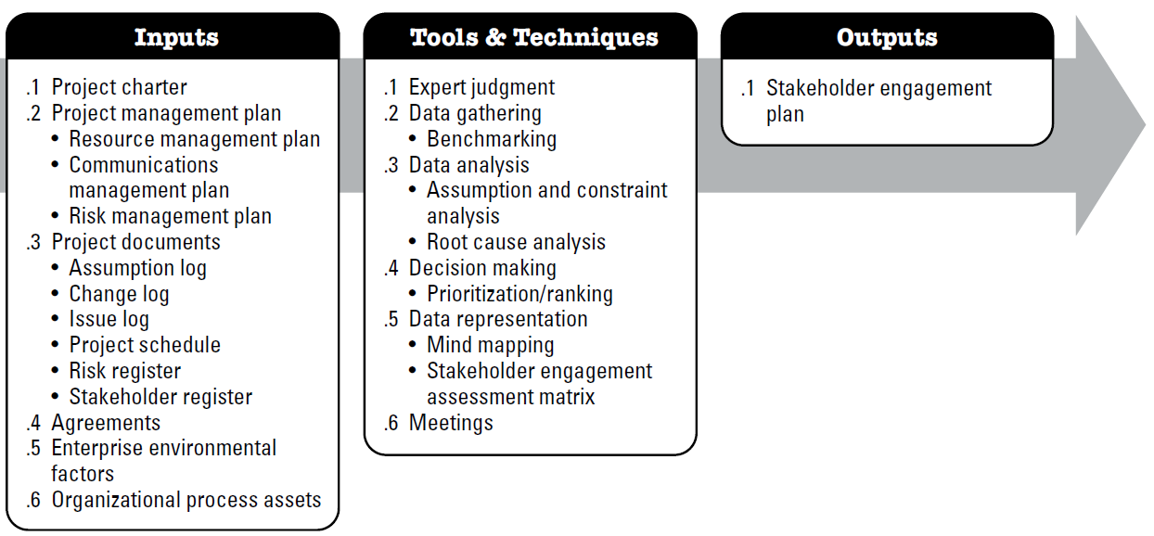
Plan stakeholder Engagement
The process of developing appropriate management strategies to effectively engage stakeholders throughout the project lifecycle.

Slide 77
Plan stakeholder Engagement
Input:
Project management plan
Resource management plan, Communications management plan, Risk management plan
Project documents
Assumption log , Issue log, project schedule, change log, stakeholder register, risk register
Agreements
involves working with the procurement/contracting group in the organization to ensure contractors and suppliers are effectively managed.
contains information on the project purpose, objectives, and success criteria that can be taken into consideration when planning how to engage stakeholders.
Project Charter
EEF - Organizational culture, political climate, and governance framework, Personnel administration policies, Stakeholder risk appetites, Established communication channels
EEF

Slide 78
Plan stakeholder Engagement
Input:
Corporate policies and procedures for social media, ethics, and security;
OPA
Corporate policies and procedures for issue, risk, change, and data management;
Organizational communication requirements;
Lessons learned repository with information about the preferences, actions, and involvement of stakeholders; and
Software tools needed to support effective stakeholder engagement.
Standardized guidelines for development, exchange, storage, and retrieval of information;

Slide 79
Plan stakeholder Engagement
Tools & Techniques:
Expert judgment
Data Gathering
Data Analysis
Decision Making
Data Representation - Mind mapping, Stakeholder engagement assessment matrix
Meetings
The engagement level of stakeholders can be classified as follows:
Unaware. Unaware of the project and potential impacts.
Resistant. Aware of the project and potential impacts but resistant to any changes that may occur as a result of the work or outcomes of the project. These stakeholders will be unsupportive of the work or outcomes of the project.
Neutral. Aware of the project, but neither supportive nor unsupportive.
Supportive. Aware of the project and potential impacts and supportive of the work and its outcomes.
Leading. Aware of the project and potential impacts and actively engaged in ensuring that the project is a success

Slide 80
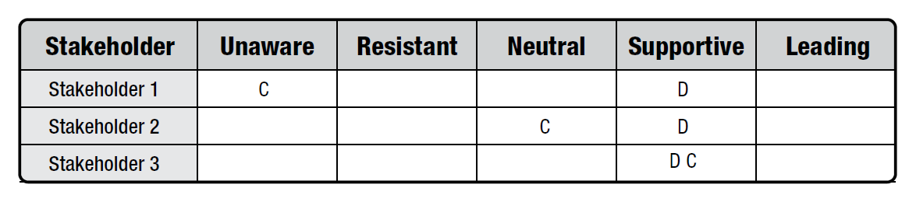
Plan stakeholder Engagement
Tools & Techniques:
Stakeholder engagement assessment matrix
C represents the current engagement level of each stakeholder
D indicates the level that the project team has assessed as essential to ensure project success (desired).
The gap between current and desired for each stakeholder will direct the level of communications necessary to effectively engage the stakeholder.

Slide 81
Plan stakeholder Engagement
Output:
Stakeholder Engagement plan
identifies the strategies and actions required to promote productive involvement of stakeholders in decision making and execution. It can be formal or informal and highly detailed or broadly framed, based on the needs of the project and the expectations of stakeholders.
Project schedule, Stakeholder register
PROJECT DOCUMENTS UPDATES

Slide 82
Develop Project Management Plan
The process of defining how the project will be executed, monitored, controlled and closed
Process
Output
Develop Project Management Plan
Project management plan

Slide 83
Develop Project Management Plan
What does it(PM Plan) contain
Project management processes selected by team
The description of tools and techniques to be used
How the selected processes will be used to manage the project
How work will be executed
How changes will be monitored and controlled
All subsidiary plans from other process group
How configuration Management will be performed

Slide 84
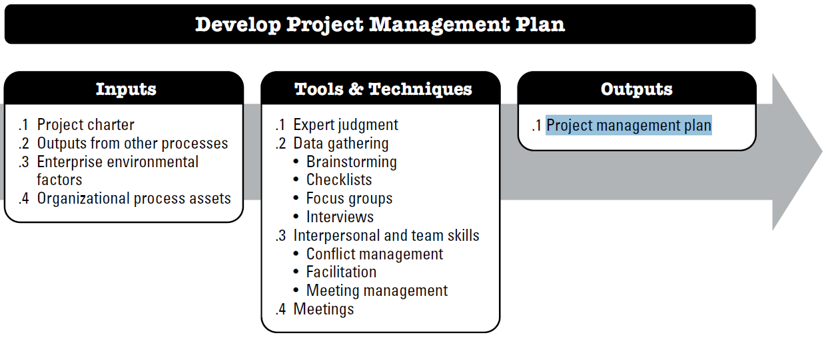
Develop Project Management Plan

Slide 85
Develop Project Management Plan
Input:
Project Charter
Project managers get high level guideline from the charter
Output from other processes
Output already discussed for other planning processes are integrated to project management plan
EEF
Govt or industry standard
OPA
Standard guidelines, work instruction, proposal evalution criteria and performance measurement criteria
Includes baseline and subsidiary management plan
PMIS
Organizational Culture
Personnel Administration
Infrastructure
PM template
Change control procedure
Project file from past projects

Slide 86
Develop Project Management Plan
Tools & Techniques:
Expert judgment
Data Gathering
Interpersonal and team skills
Meetings

Slide 87
Develop Project Management Plan
Output:
Project Management Plan
How work will be implemented
Change and configuration management plan
How the performance will be measured
Baselines
  –Scope
  –Schedule
  –Cost
Subsidiary Plans
  –Scope, Requirement, schedule, cost, Quality, process improvement, HR, Communication, risk and procurement management plan.

Slide 88
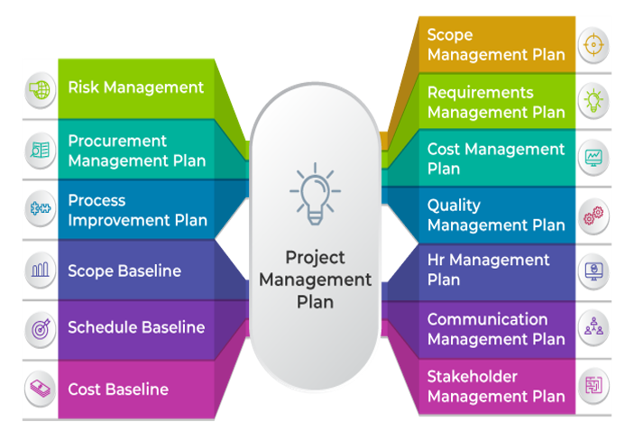

Slide 89
Project Management Plan (The PM Plan)
Defines how the project will be executed, monitored, controlled and closed.
  Defines, integrates and coordinates all other plans and baselines
  It’s content will vary depending on the application area and project complexity
  Progressively elaborated

Slide 90
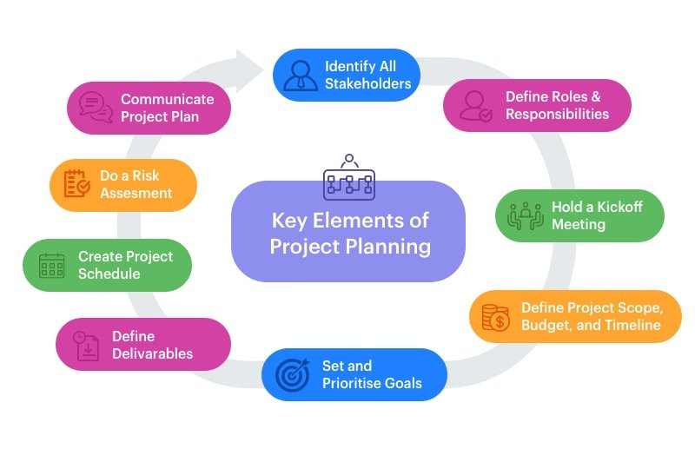
Project Management Plan (How to prepare)

Slide 91
End of Planning Process Group

